Slide 1
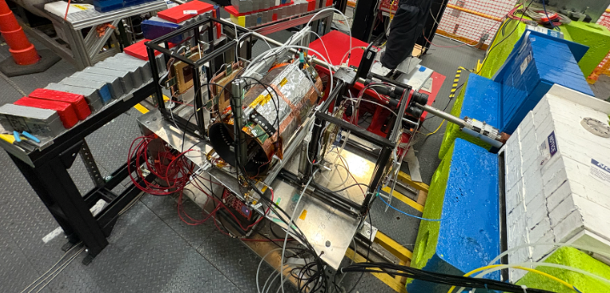
Mapping for a Cylindrical Micro-Resistive Well Detector
Milestone 2

Slide 2
People
Group Members
Faculty Advisors/Clients
Alejandro Moreno Zuluaga, moreno2023@my.fit.edu
Summer Mueller, smueller2023@my.fit.edu
Pietro Iapozzuto, piapozzuto2015@my.fit.edu
Dr. Marcus Hohlmann, hohlmann@fit.edu

Slide 3
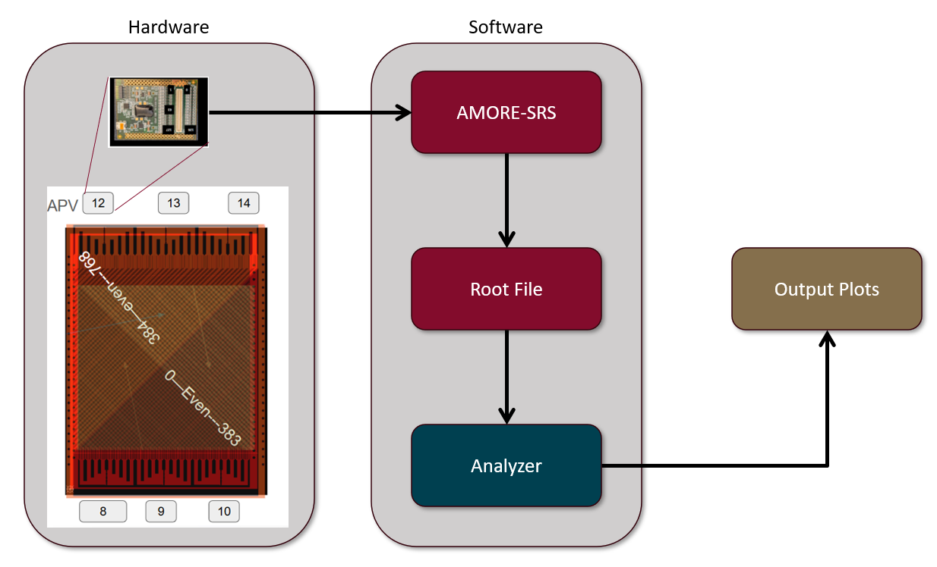
Overview

Slide 4
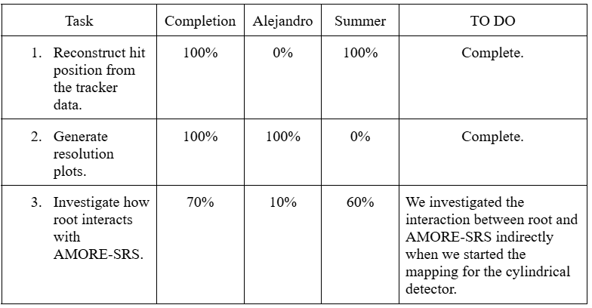
Milestone 2 Task Matrix

Slide 5
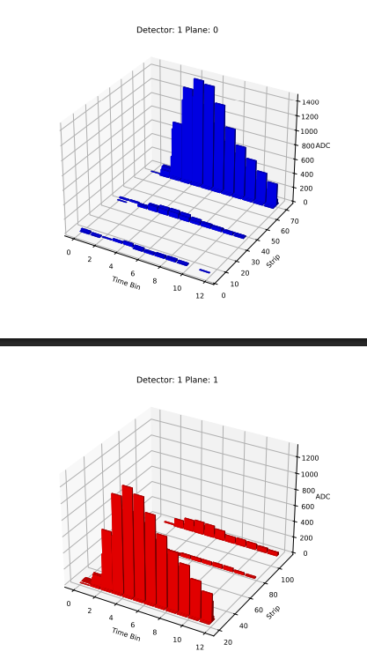
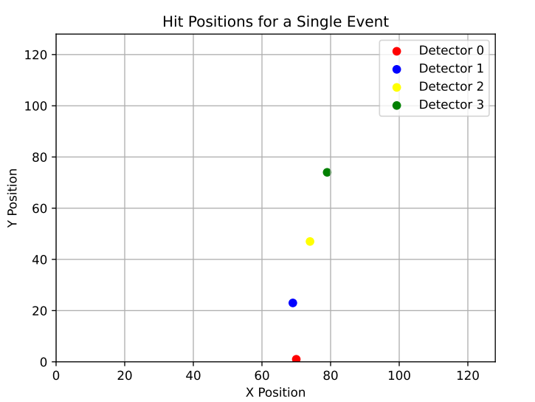
Task- Reconstruct hit positions

Slide 6
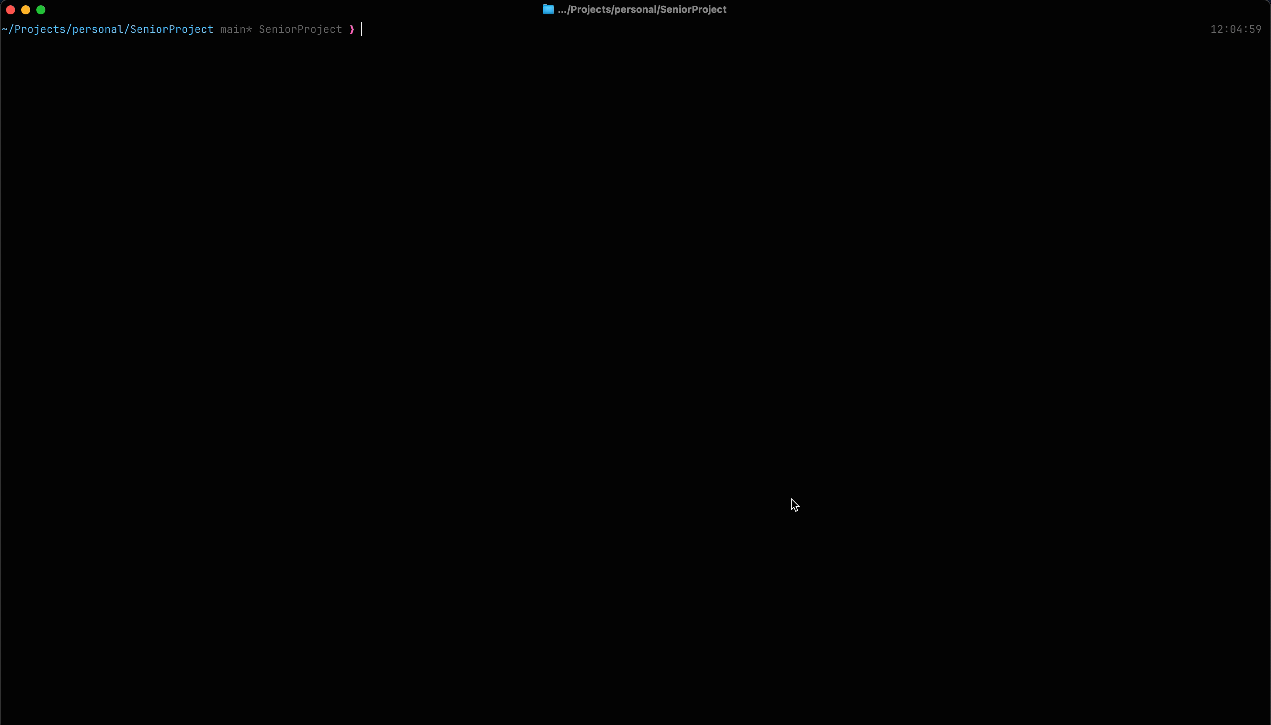
Task- Generate resolution plots

Slide 7
Task- Generate resolution plots
Filter and preprocess the data of each event.
Gathered good/useful events.
Match the hits of an event into (x, y) pairs.
Get the corresponding z value(adc) by calculating center of mass.
Plot the resulting grid.

Slide 8

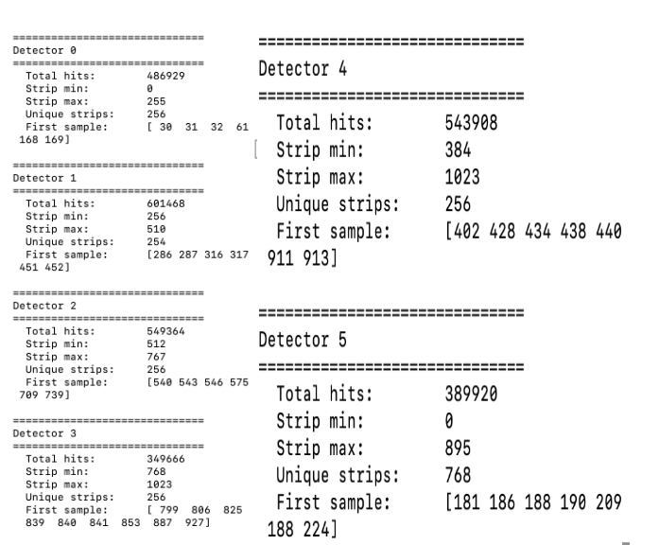
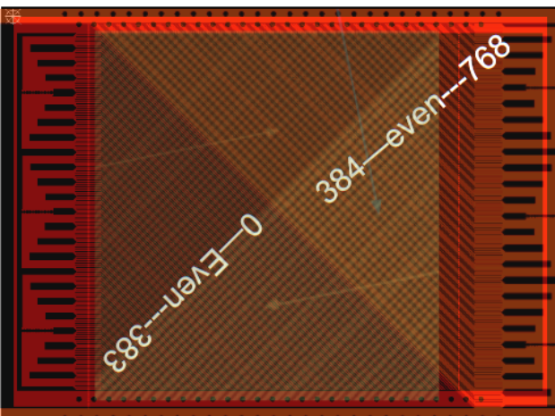
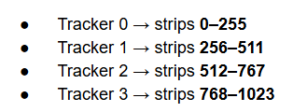
Task- Investigate AMORE-SRS representation
Planar Tracker

Slide 9
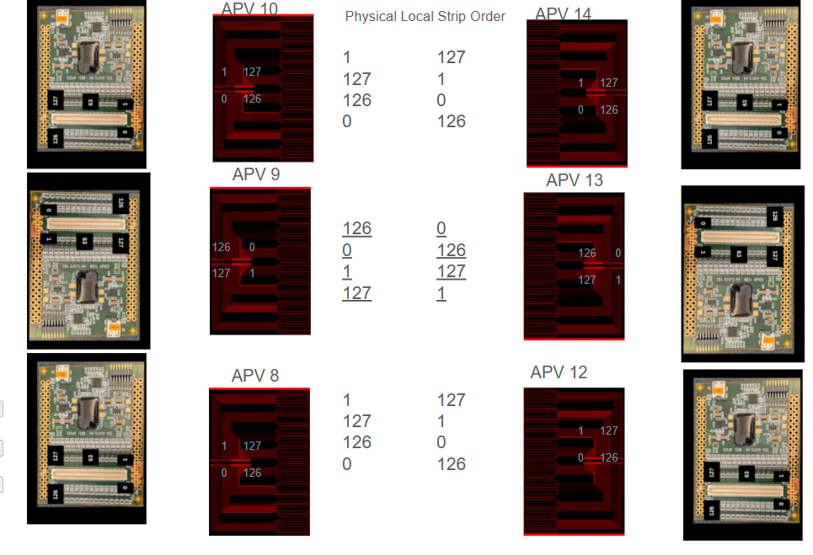
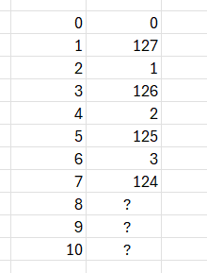
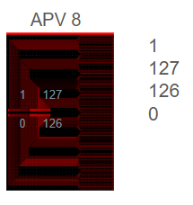
Milestone 3 Tasks
Generate cylindrical mapping functions
Resolution plots for cylindrical detector data
Validate cylindrical plots against tracker plots

Slide 10
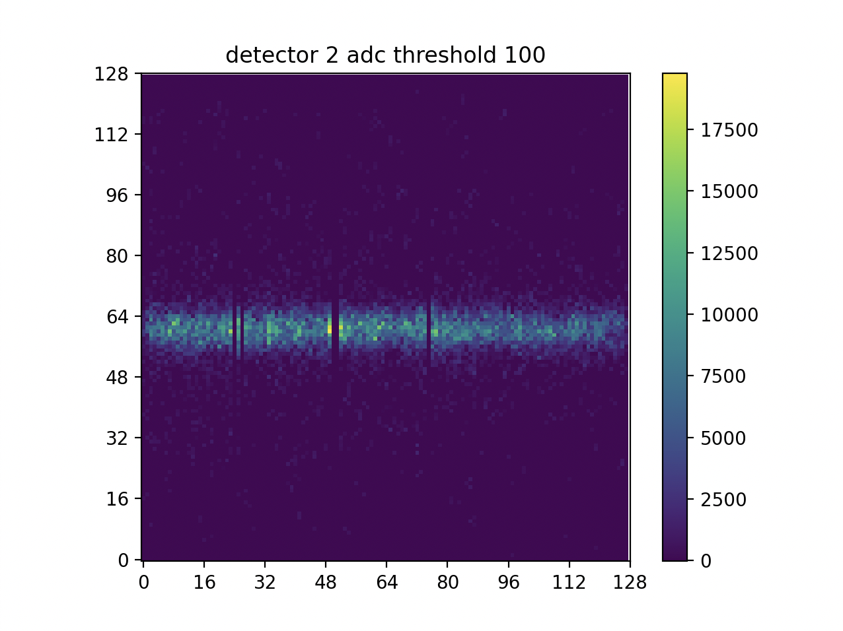
Milestone 3 Tasks
Generate cylindrical mapping functions
Resolution plots for cylindrical detector data
Validate cylindrical plots against tracker plots

Slide 11
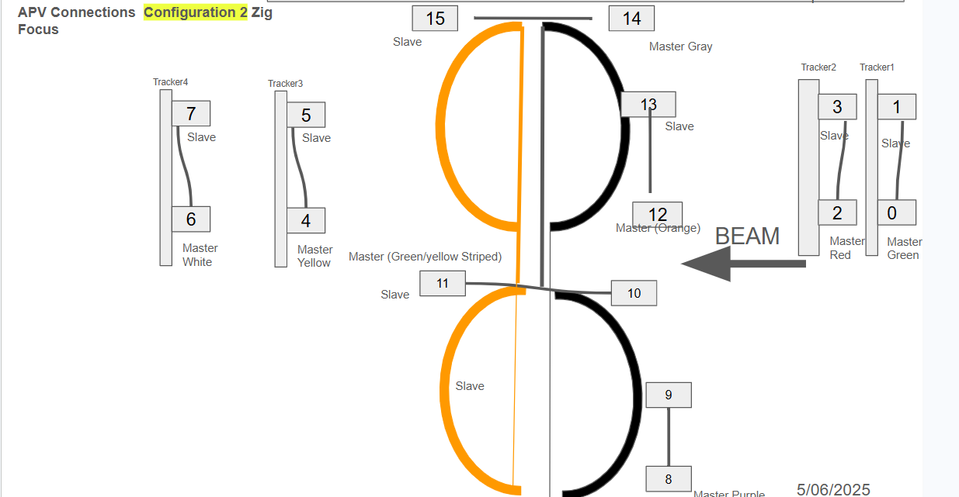
Milestone 3 Tasks
Generate cylindrical mapping functions
Resolution plots for cylindrical detector data
Validate cylindrical plots against tracker plots

Slide 12
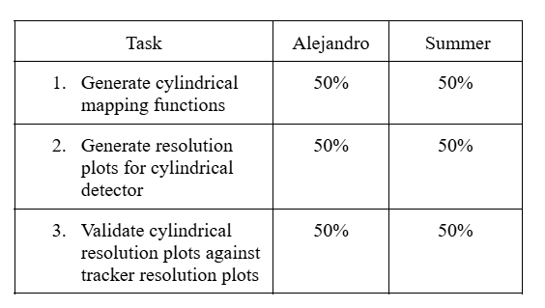
Milestone 3 Task Matrix

Slide 13
Thank you for listening
Questions?

Slide 14
Definitions
Detector- A detector is a device used in particle physics to measure the position of charged particles.
μRWELL (Cylindrical micro-resistive well detector)- μRWELL is a type of micro-pattern gaseous detector that combines gas electron multiplication with a resistive protection layer and a segmented readout structure to measure charged particles with high precision [1]. Designing a detector that is cylindrical is the novelty here.
Tracker- In the context of this project, a tracker refers to an external planar detector. Four trackers are used to create a reference system for evaluating the efficiency of the cylindrical detector.
Readout board- A readout board is an electronic circuit board that collects signals from detector channels. The readout board hosts APV chips and interfaces between the detector strips and the data acquisition system. Each readout board can only capture a single plane of the data. So in planar detectors, typically there is one for x and y positions, respectively.
Channels/strips- Channels or strips are the readout elements on the detector surface that collect charge from ionization events. Each strip is connected to a specific APV channel. Strip signals are used to reconstruct particle hit positions.
APV chip (Analog Pipeline Voltage chip)- An APV chip samples analog signals from each channel on the readout board in time bins.
Time bin- A time bin is a discrete time sample recorded by the APV chip. Typically, 12-16 time bins are used to reconstruct the pulse shape of a beam.
ADC (Analog to Digital Converter value)- ADC represents a numerical value for the current recorded on a particular strip.

Slide 15
Definitions cont.
AMORE-SRS (Analysis and Monitoring Of Readout Electronics and Scalable Readout System)- AMORE-SRS is a live data acquisition framework for monitoring and organizing the data from the APV chips into a root file for analysis.
Root file- The root file stores event data such as strip information, ADC values, and metadata. The data is organized into branches that correspond to specific variables.
3D Pulse plot- A 3D pulse plot is a visualization of a single event where the x axis is time bin, the y axis is the strip number, and the z axis is the ADC value.
Resolution plot- A resolution plot is a reconstruction of the 2d hit positions represented as a heat map.
Efficiency plot- Efficiency plots compare the detectors efficiency against other performance characteristics such as amplification or drift field. Efficiency itself is defined as the ratio of the number of events with strip clusters seen in all five detectors divided by the number of events with strip clusters seen in just the four trackers [2].

Slide 16
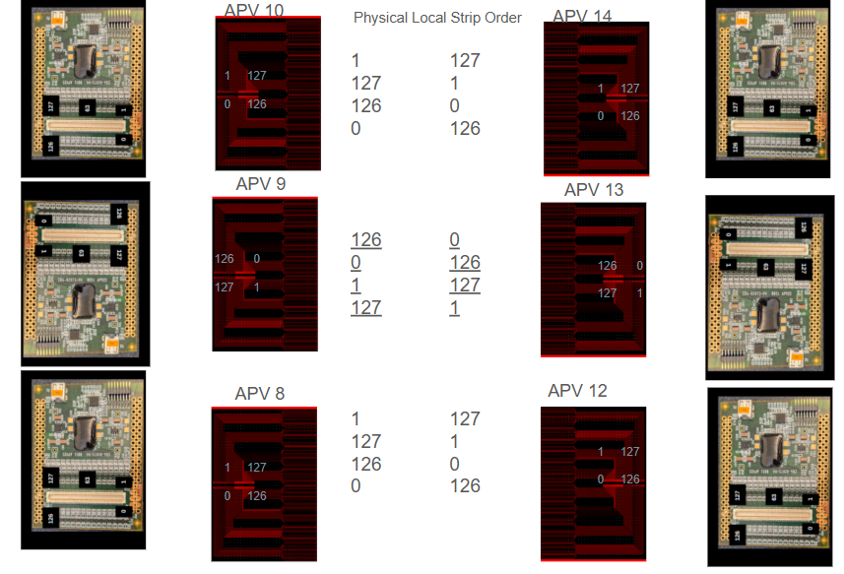
Channel Orientations

Slide 17
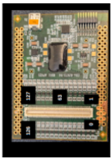
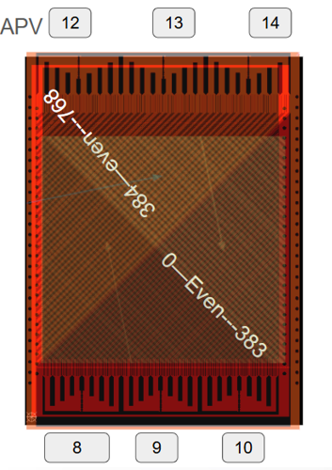
Hardware
Software
AMORE-SRS
Root File
Output Plots
Analyzer

